Slide 1
Lesson 2:
Review of solid state physics

Slide 2
A) Short review of quantum mechanics
- De Broglie relation
- Heisenberg uncertainty principle
- Schrödinger wave equation and applications
Time-dependent

Slide 3
Time-independent
Engineering V→Engineering the nanostructure electronic properties
Free particle: V=0
Hydrogen atom: V∝1/r

Slide 4
Harmonic oscillator: V∝r²
Infinite square well potential: V(z)=0, 0<z<a; V(z)=∞, z<0, z>a
E
V₀
0
z
a

Slide 5
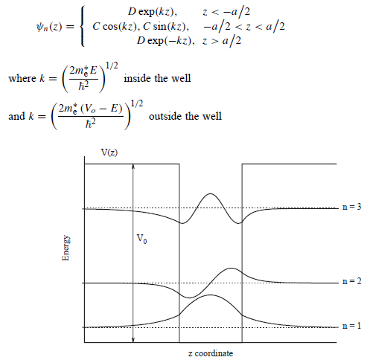

Slide 6
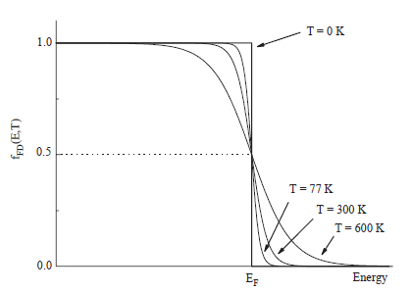
- Fermi-Dirac distribution
It plays a key role in the distribution of electrons in nanostructures

Slide 7
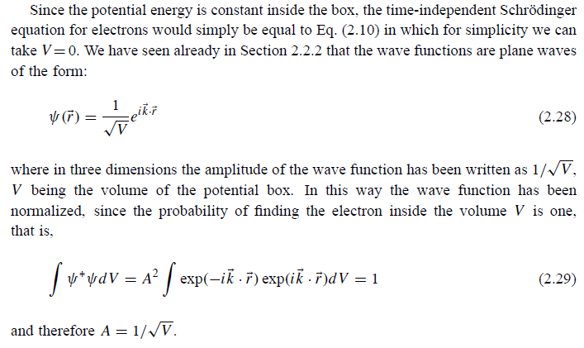
B) Free electron model of a solid; Density of states function

Slide 8
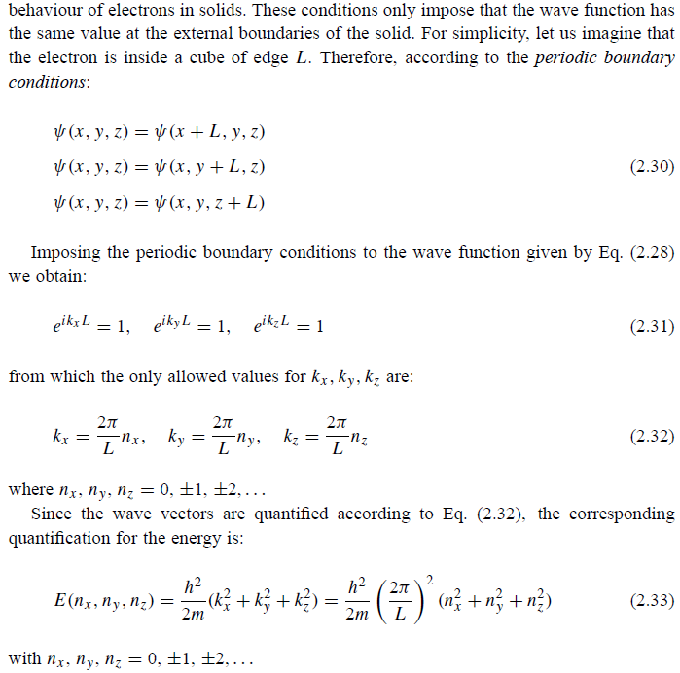
Born-von Karman conditions

Slide 9
Density of states

Slide 10
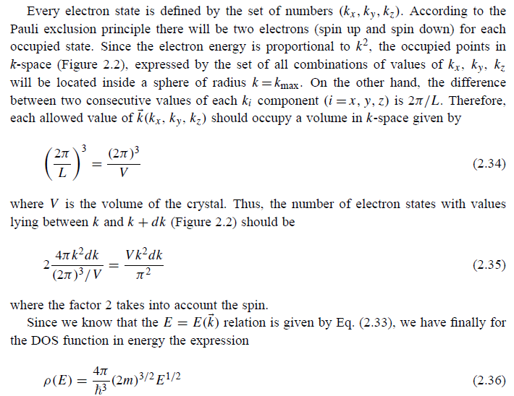
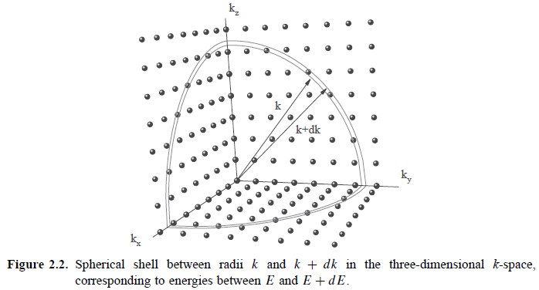

Slide 11
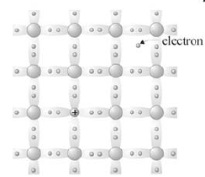
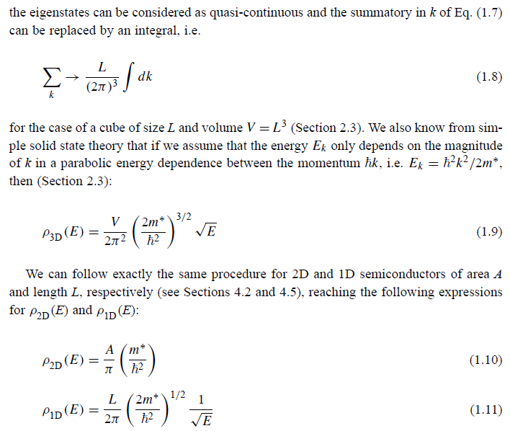

Slide 12
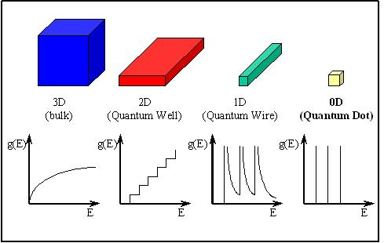
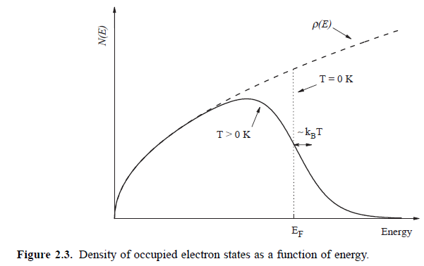
T=0 K

Slide 13
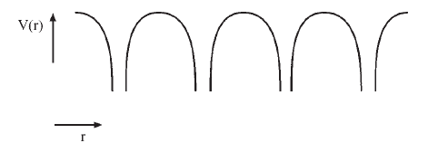
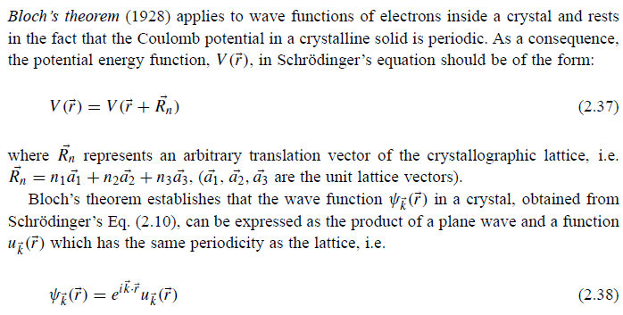
C) Bloch theorem
Bloch states

Slide 14
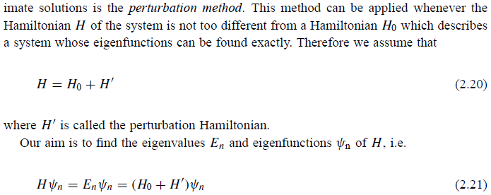
D) Electrons in crystalline solids
Nearly free electron model (perturbation method)
a

Slide 16
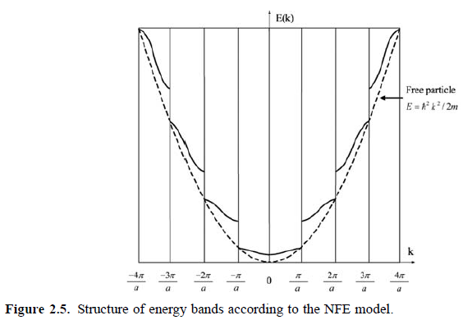
E_{G}
Metal: no energy gaps (free electrons, parabola)
Semiconductors: E_{G}~0.7-3 eV
Insulators: E_{G}>3 eV

Slide 17
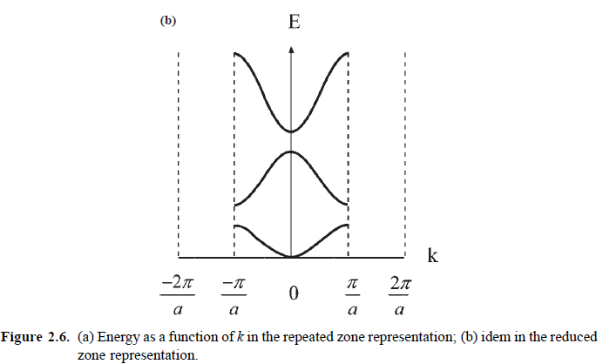
Riduzione alla prima zona di Brillouin

Slide 18
E) Dynamics of electrons in bands
- Equation of motion

Slide 19
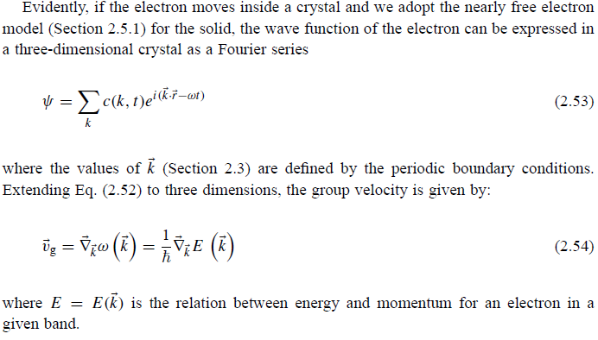

Slide 20
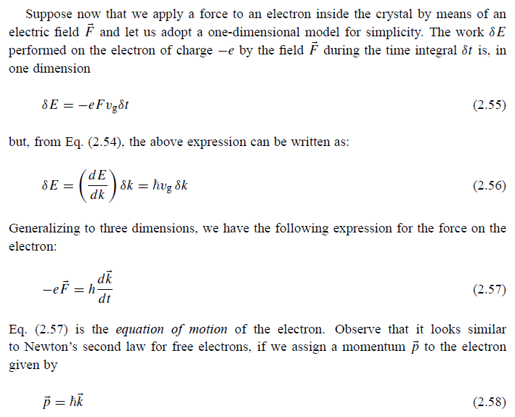
Crystal momentum

Slide 21
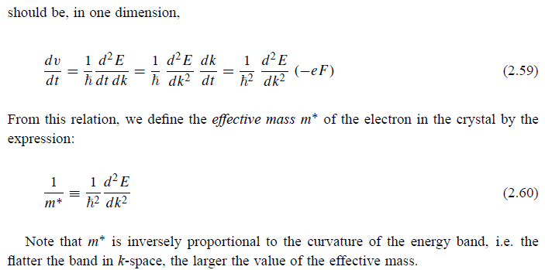
- Effective mass

Slide 22
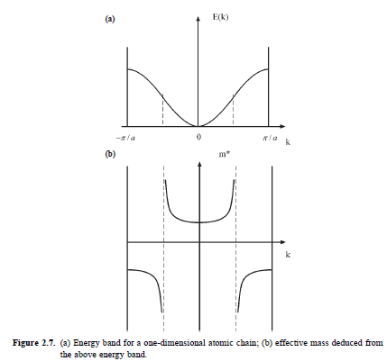

Slide 23
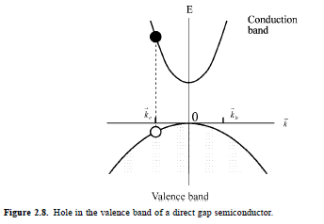
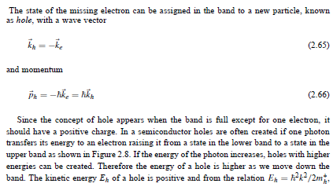
- Holes

Slide 24
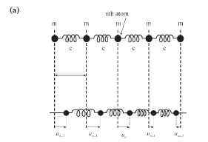
E) Lattice vibrations (Phonons)
- 1D monoatomic lattice

Slide 25
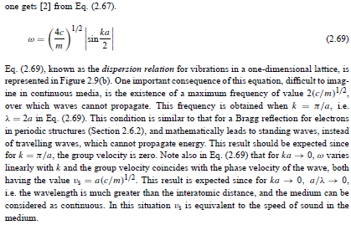
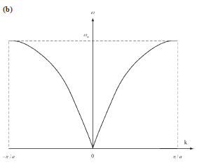

Slide 26
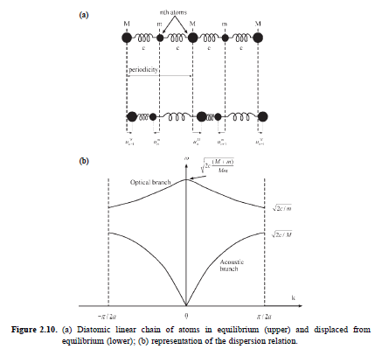
- 1D biatomic lattice

Slide 27
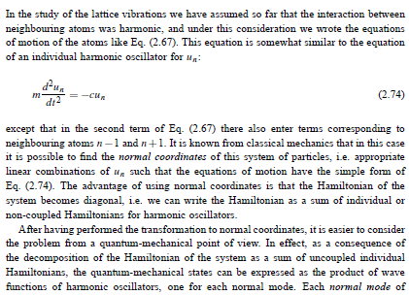
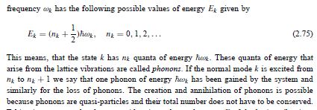
- Phonons

