Slide 1
Lesson 5, Part 2:
Electric field induced transport in nanostructures

Slide 2
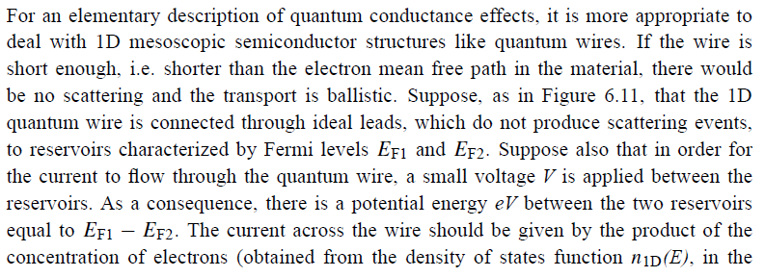
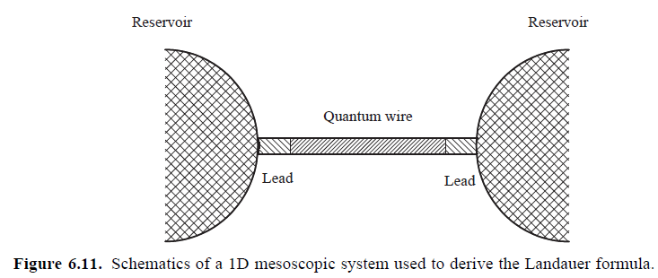
A) Quantized conductance. Landauer formula
Another particular case of the Landauer formula

Slide 3
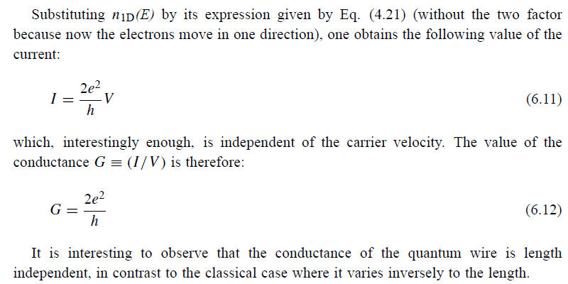

Slide 4
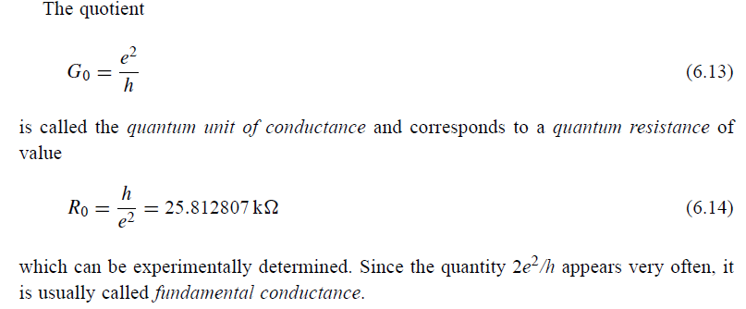

Slide 5
The general derivation of the Landauer Formula: coherent transport with many channels
Two leads with many channels (subbands)

Slide 6
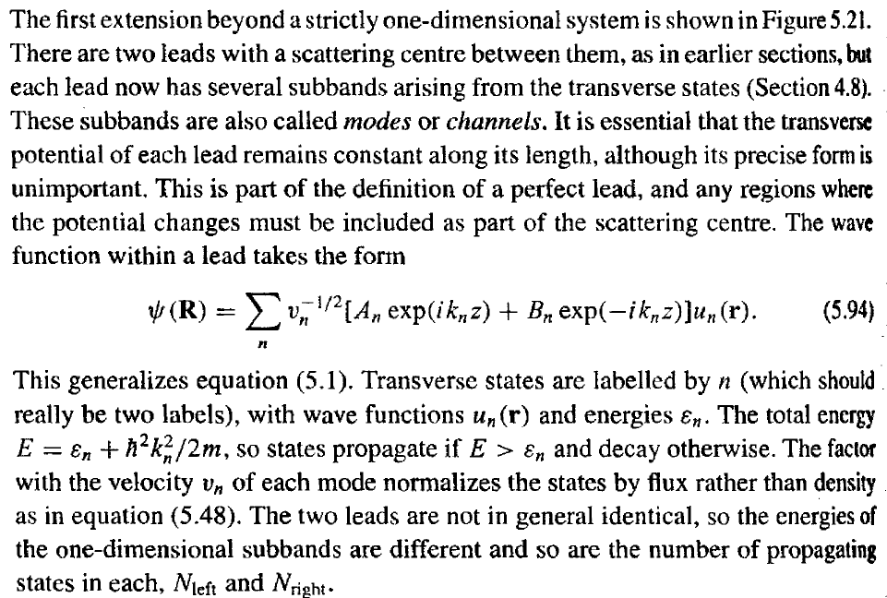

Slide 7
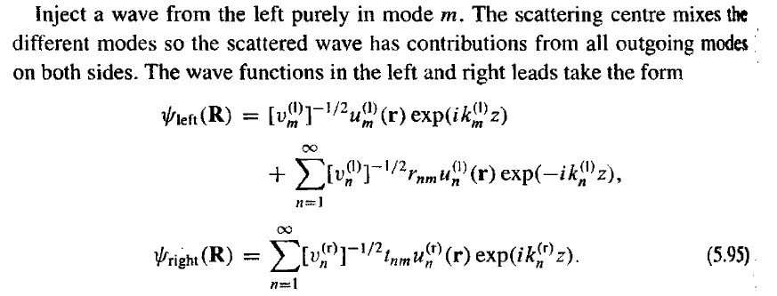

Slide 8
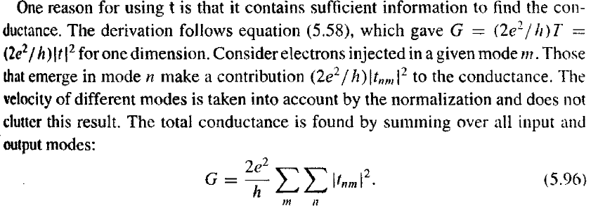

Slide 9
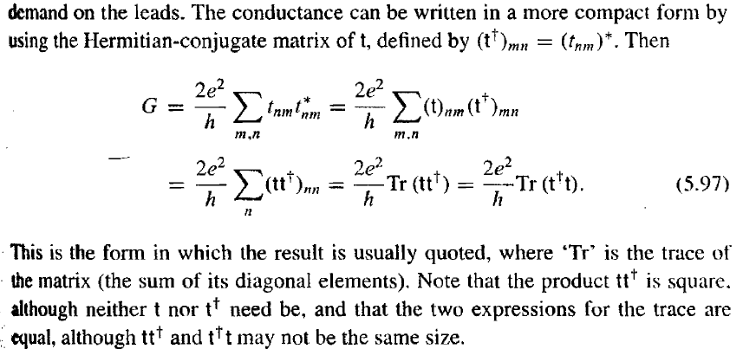
Mesoscopic conductance
A new interpretation for the resistance (or conductance) of a mesoscopic system
T
R
G=(2e²/h) T/R
Landauer Formula: conductance as transmission

Slide 10
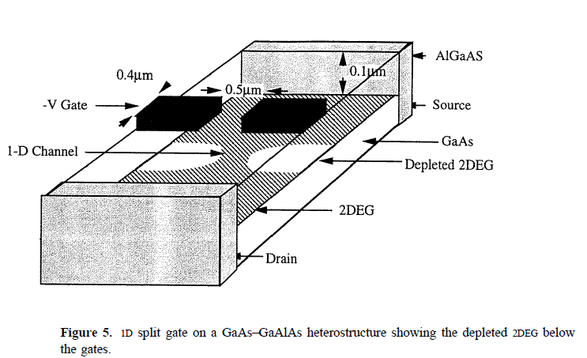
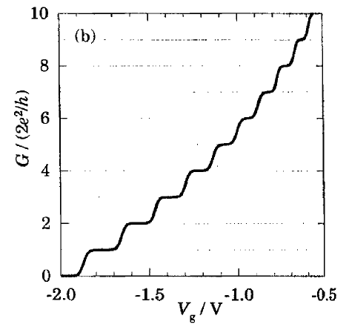
Quantum point contact for a 2DEG

Slide 11
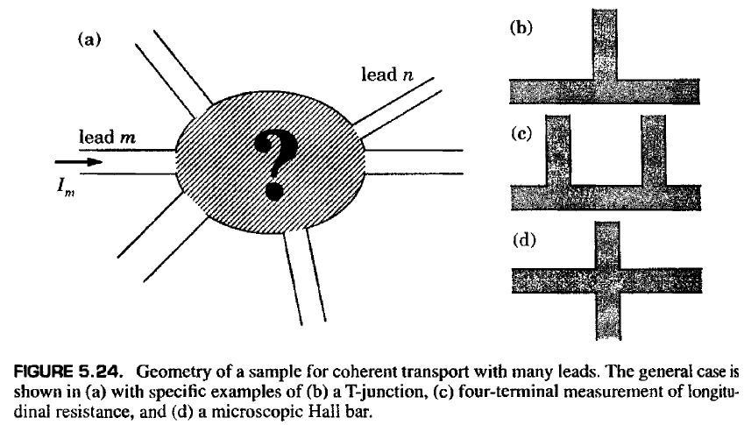
B) Landauer-Büttiker formula for multi-probe quantum transport (Systems with many leads)

Slide 12
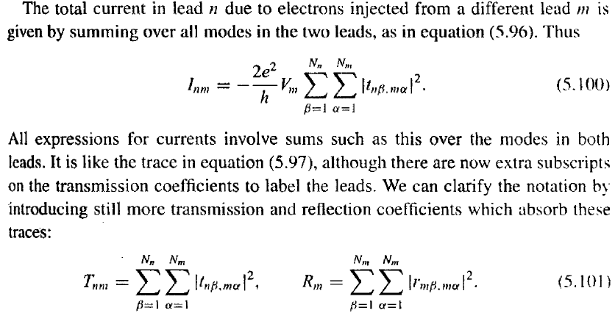

Slide 13
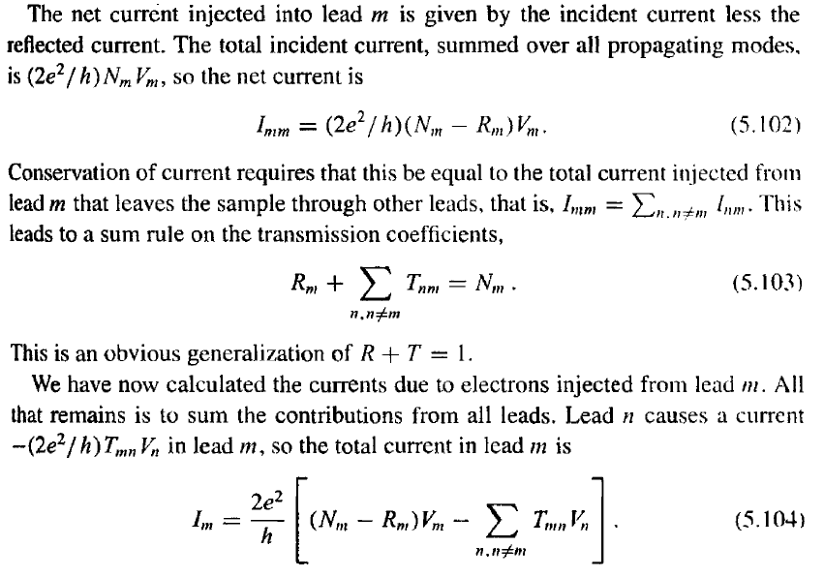
Landauer-Buttiker formula: replaces the Ohm law

Slide 14
a) Two terminals system
G: 2x2 matrix
µ₁
µ₂

Slide 15
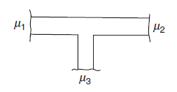
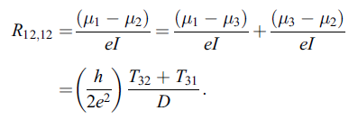
b) Three terminals system
G: 3x3 matrix

Slide 16
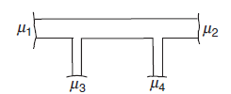
c) four terminals system
G: 4x4 matrix

Slide 17
Some applications of the Landauer-Büttiker formula

Slide 18
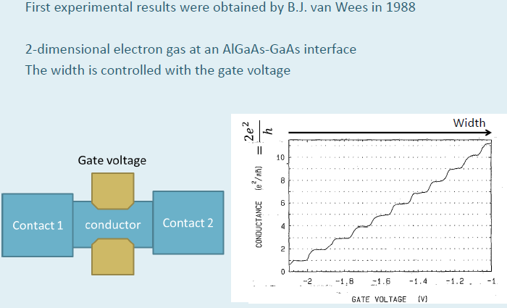
1) Quantum point contact for a 2DEG
The gate voltage defines the width of the constriction (so the number of transmitted modes)

Slide 19
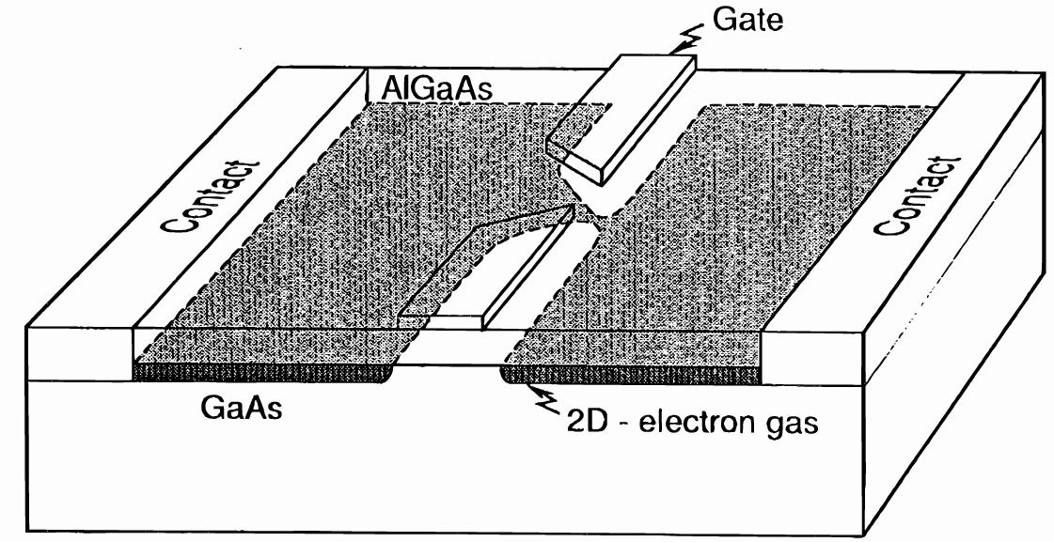
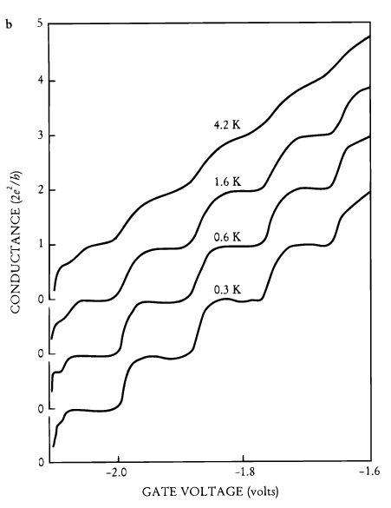
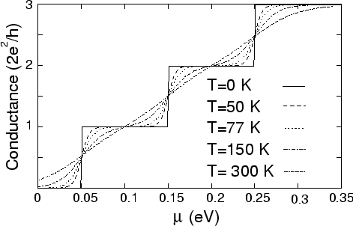
Quantum point contact for a 2DEG

Slide 20
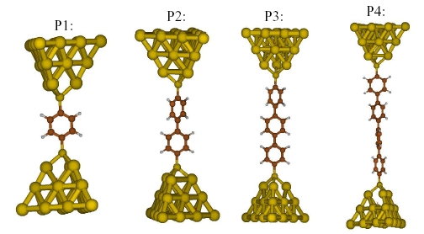
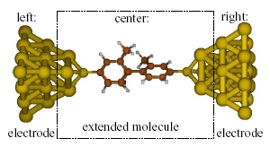
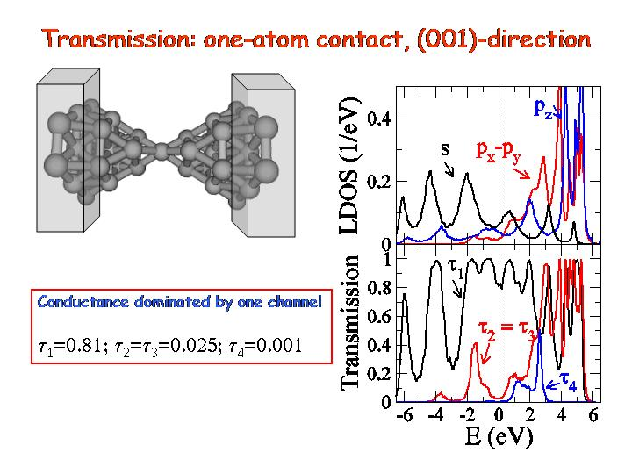
2) Electronic transport in single-molecule junctions

Slide 21
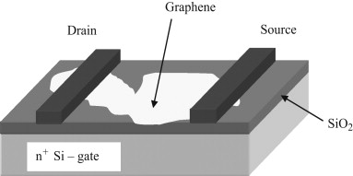
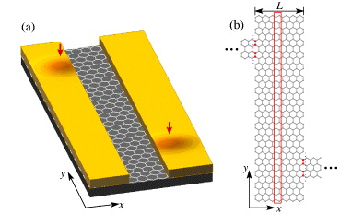
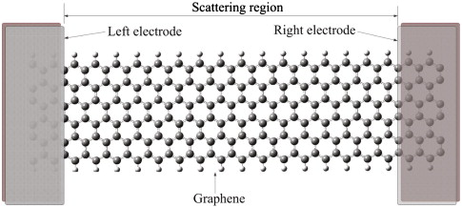
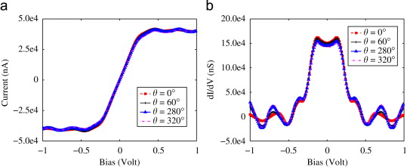
3) Longitudinal electronic transport in 2D graphene

Slide 22
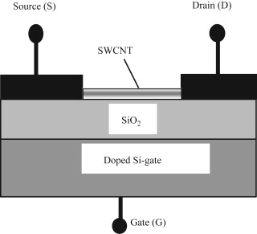
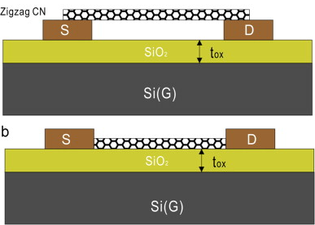
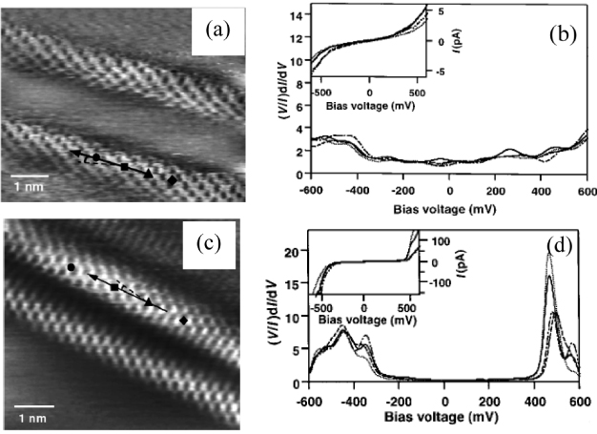
4) Longitudinal electronic transport in carbon nanotube

Slide 23
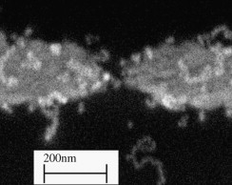
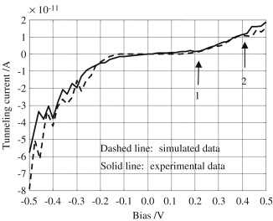
5) Electronic transport in nanoparticles and chains of nanoparticles

Slide 24
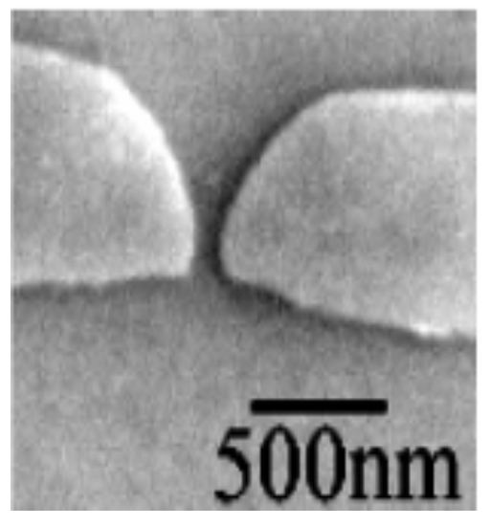
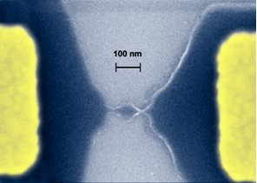
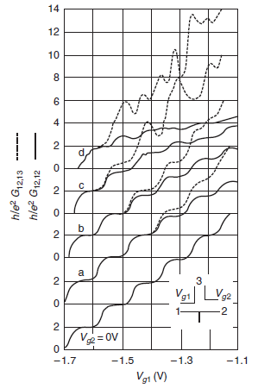
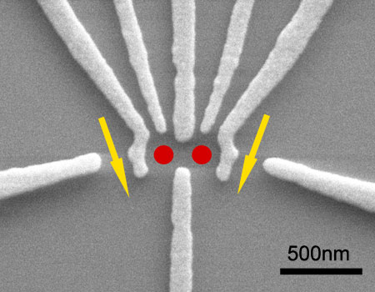
6) Multiterminal quantum point contacts
3-terminals QPC

