Slide 1
Lesson 6
Magnetic field induced transport in nanostructures

Slide 2
- Short review of the effects of a magnetic field on an electron in bulk system
- Effects of a magnetic field on an electron in 0D, 1D, 2D nanostructures (modification of the density of states!!)
- Quantization of the magnetic flux
- Quantum Hall effect

Slide 3
A) Effect of a uniform magnetic field on a crystal

Slide 4
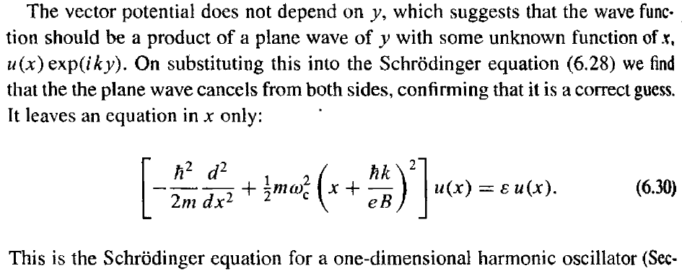

Slide 5
Free electrons in y and z. Confined electrons in x (by harmonic potential)
Landau Levels

Slide 6
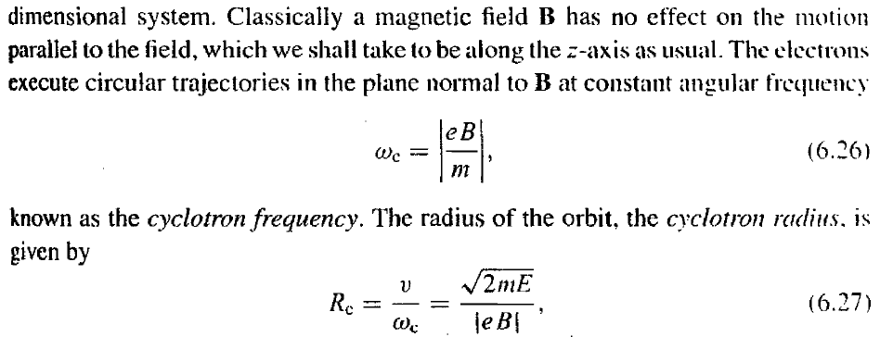

Slide 7
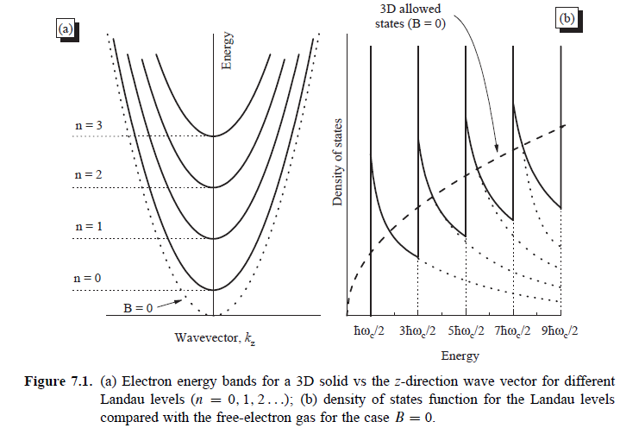
Landau Levels
Key consequence: Changing the electrons density of states
Landau Levels
n_{3D}→n_{1D}

Slide 8
B) Low dimensional systems in magnetic fields
n_{3D}→n_{1D}
General effect of a magnetic field on the electrons density of states: restriction by 2 dimensions
n_{2D}→n_{0D}
2D
0D

Slide 9
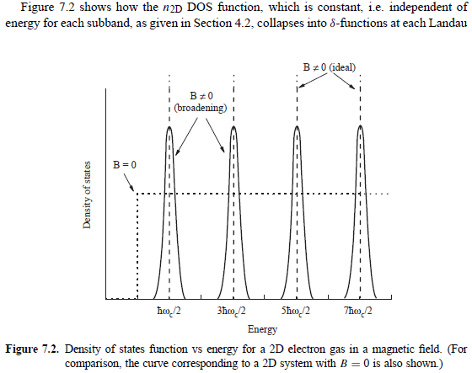
C) Density of states of a 2D system in a magnetic field (Towards the quantum Hall effect)

Slide 10
D) The Aharonov-Bohm effect: evidence for the magnetic flux quantization
L_{φ}>>L, B≠0→Electrons interference effects

Slide 11
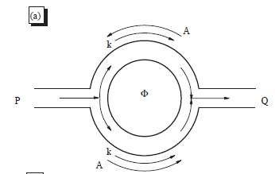
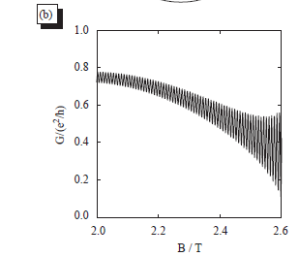
Webb experiment to prove the Aharonov-Bohm effect

Slide 12
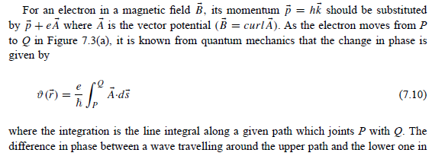
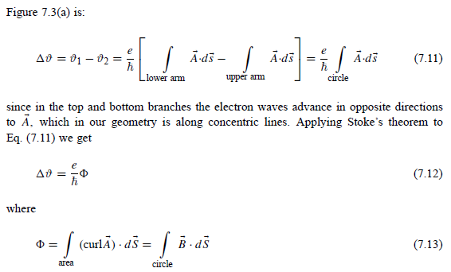

Slide 13
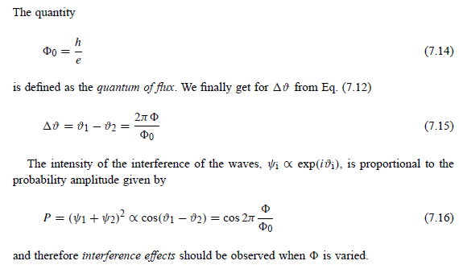

Slide 14
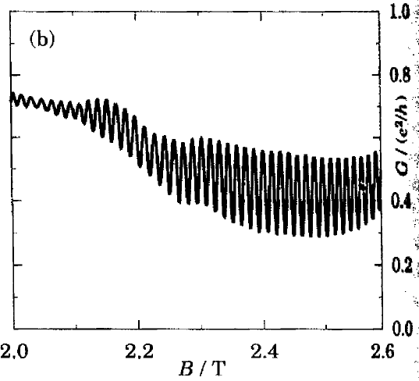

Slide 15
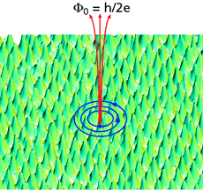
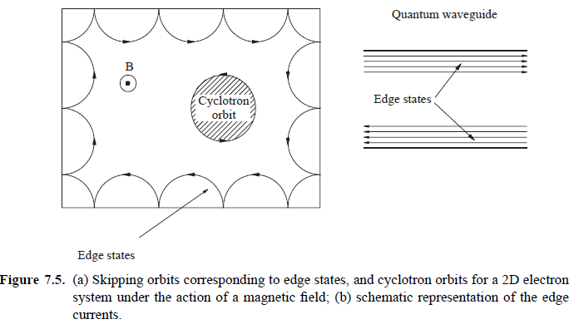

Slide 16
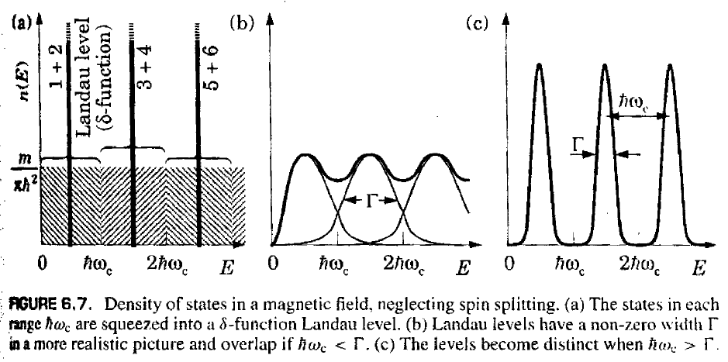
E) 2D system in a magnetic field: Landau levels and filling factor

Slide 17
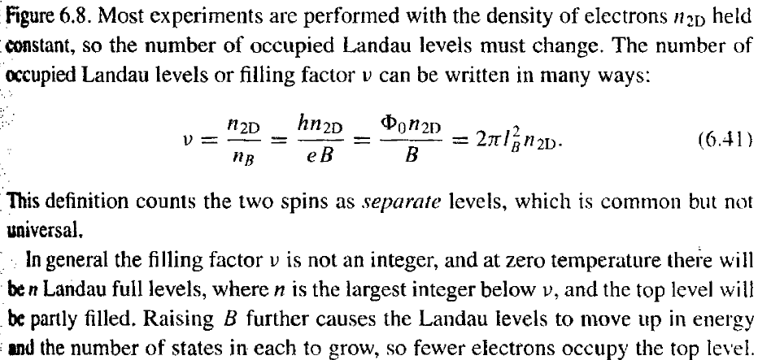
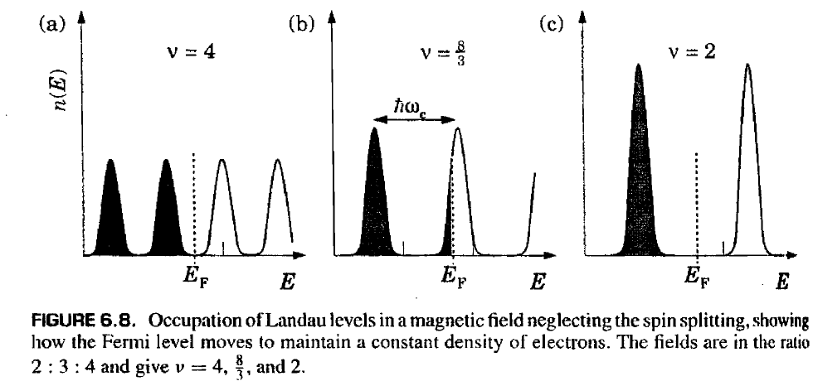
4
2
2

Slide 19
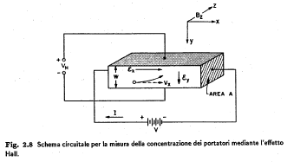
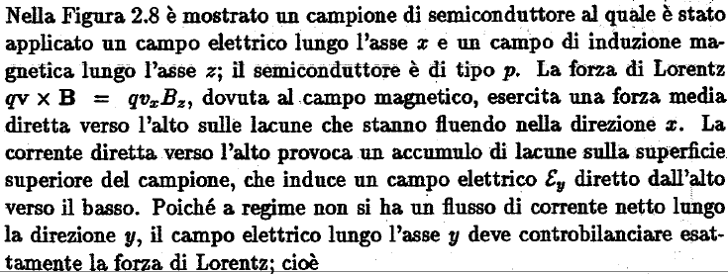
F) The quantum Hall effect
- Classical Hall effect

Slide 20
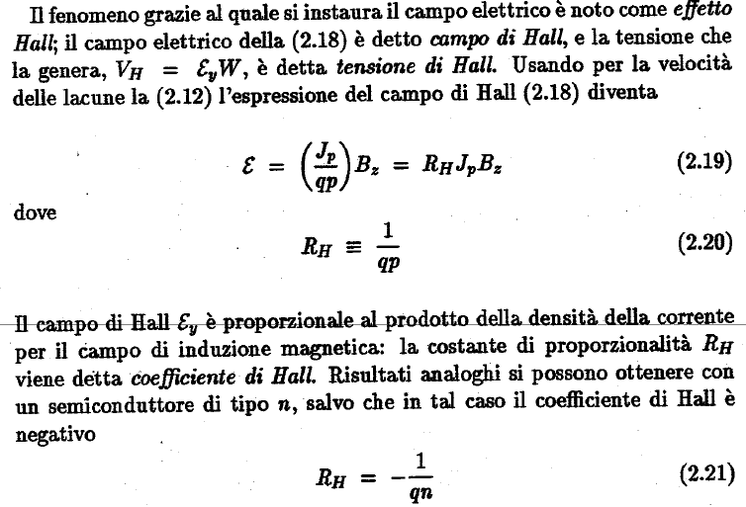

Slide 22
Quantum Hall effect
- Experimental facts and elementary theory of integer quantum Hall effect
Low-Dimensional semiconductor (ex. 2DEG)

Slide 23
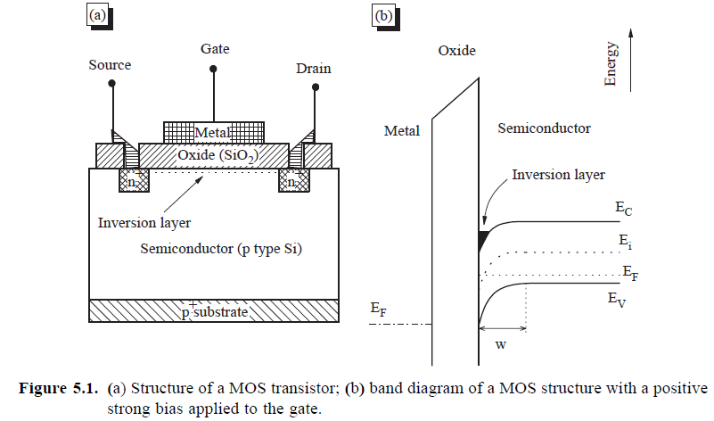
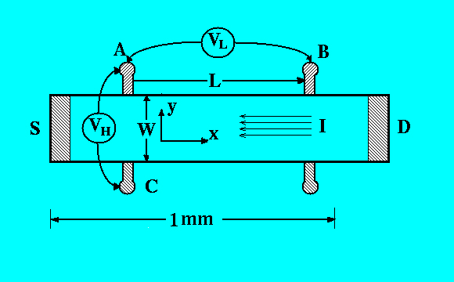
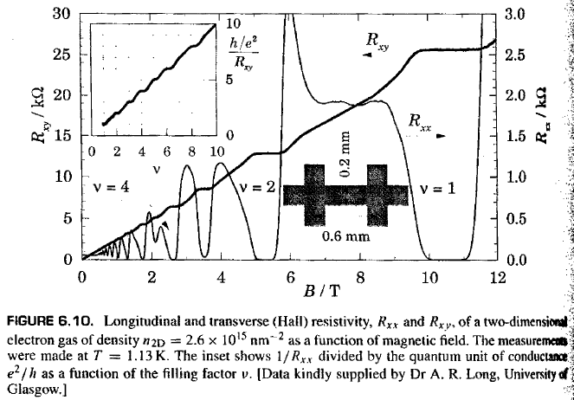
R_{xy}=R_{H}
R_{xx}

Slide 24
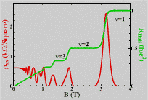
R_{K}=h/e² von Klitzing constant (quantum of resistance)

Slide 25
$$R_{H}=\frac{V_{H}}{I}=\frac{bBv}{bevn_{2d}}=\frac{B}{{en}_{2d}}$$
$$R_{H}=\frac{h}{e^{2}} \frac{1}{n}$$
$$B=B_{n}=\frac{{hn}_{2D}}{en}$$

Slide 26
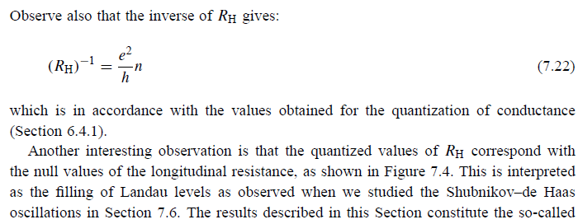
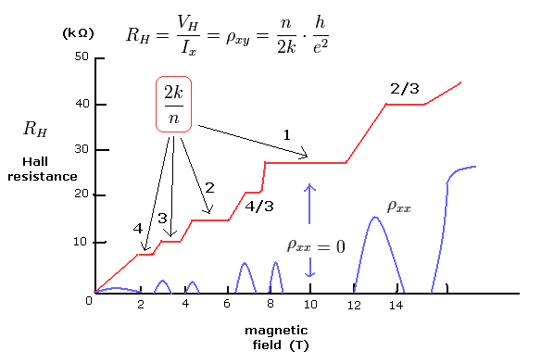
n=ν

